Slide 1
Crime Trends in Austin: Seasonal Insights from 2003 to 2023
By: Julie Ramsey
Prashant Chintakindi
Sarah Dutton

Slide 2
Resources
CSV Source: https://data.austintexas.gov/Public-Safety/Crime-Reports/fdj4-gpfu/about_data
Python Documentation and Tutorials
Python Libraries and Packages
Development Tools: Visual Studio Code
Version Control: Git and Github
Collaboration and Communication: Slack and Zoom
Instructional Staff: Travis Hopkins (Instructor)
Kian Layson (TA)

Slide 3
Limitations
This dataset contains a record of incidents that the Austin Police Department responded to and wrote a report.
Please note one incident may have several offenses associated with it, but this dataset only depicts the highest level offense of that incident.
Data is from 2003 to 2023. This database is updated weekly, and a similar or same search done on different dates can produce different results. We collected our data on June 20th 2024.
The total records were above 2.3 million which we have further filtered.
We are using this for educational purposes only.

Slide 4
Research Questions to Answer
How do seasonal variations impact the occurrence of different types of crimes in Austin?
How has crime evolved over the years as Austin continues to grow?
Which seasons have the most occurrences of crime?

Slide 5
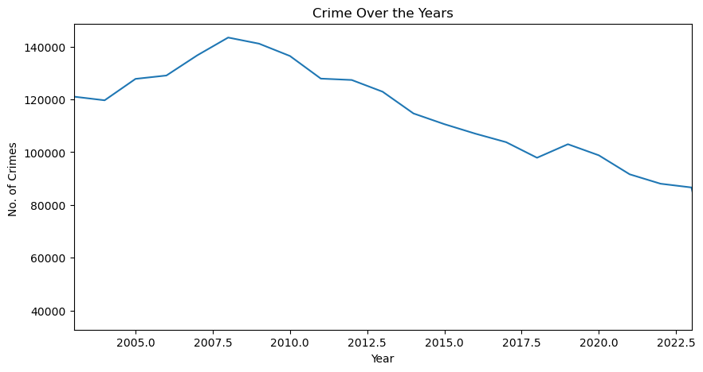
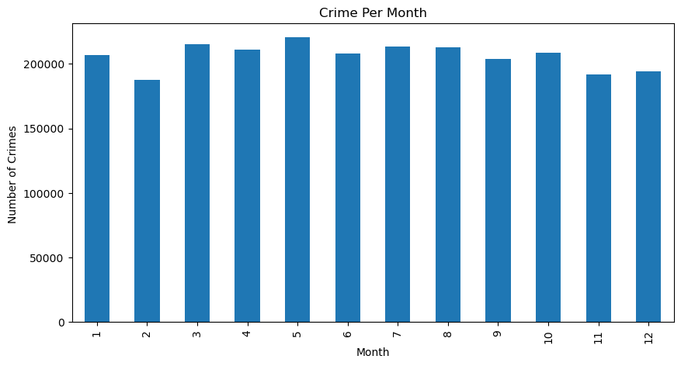
Basic Analysis
Notes:
Sole curiosity… crime analysis over the years in Austin, TX
From the bare eye, the months look evenly distributed when it comes to crime in general

Slide 6
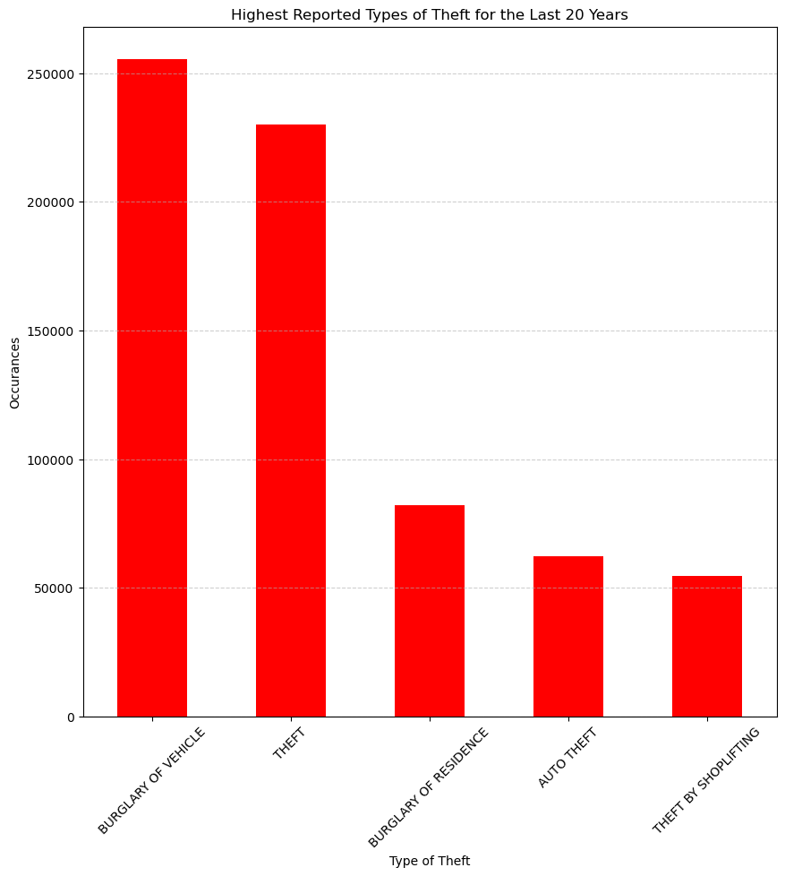
Focus In
Which types of theft crimes were reported the most?
Critical value =7.81

Slide 7
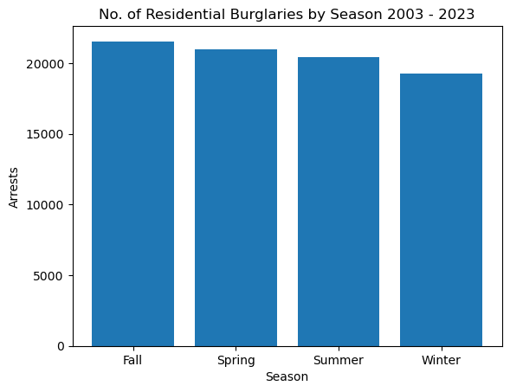
Residential Burglaries by Season
Looks to be less in the Winter
Chi-Square Statistic: 68.10
p-value: 1.09e-14
With a very high chi-square value and a very low p-value this tells us that we can reject the null hypothesis
SEASON COULD DEFINITELY BE AFFECTING THE NUMBER OF RESIDENTIAL BURGLARIES

Slide 8
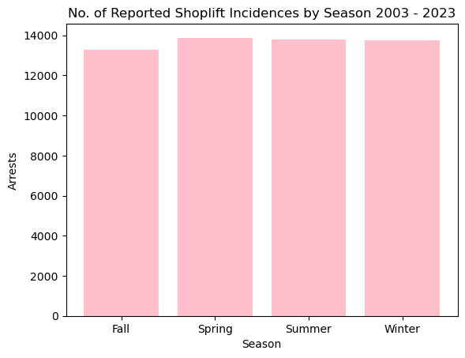
Shoplifting
Pretty even, but maybe less in the fall
Chi-Square Statistic: 8.16
P-value: 0.04
Chi-Square number is still above the critical value, and P-Value is still lower than 0.05. Although, the values are closer than the other topics of study.
SEASON COULD DEFINITELY BE AFFECTING THE NUMBER OF SHOPLIFTING

Slide 9
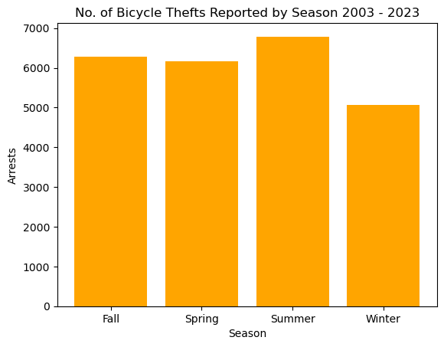
Bicycle Thefts
Low In The Winter
High In The Summer
Chi-Square Statistic: 133.90
P-value: 7.8e-29
With a very high chi-square value and a very low p-value this tells us that we can reject the null hypothesis
SEASON COULD DEFINITELY BE AFFECTING THE NUMBER OF BICYCLE THEFTS

Slide 10
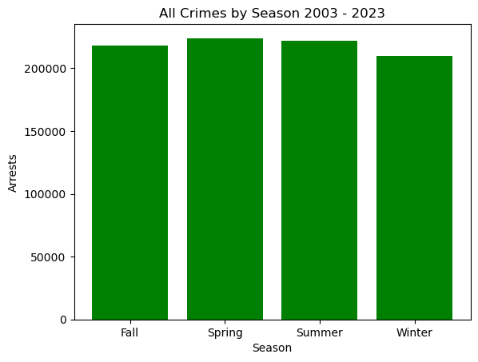
ALL CRIMES BY SEASON CHI SQUARE TEST
Chi-Square Statistic: 280.60
P-value: 1.57e-60
REJECT NULL HYPOTHESIS
This means.. Season could be having an impact on crime rate!!

Slide 11
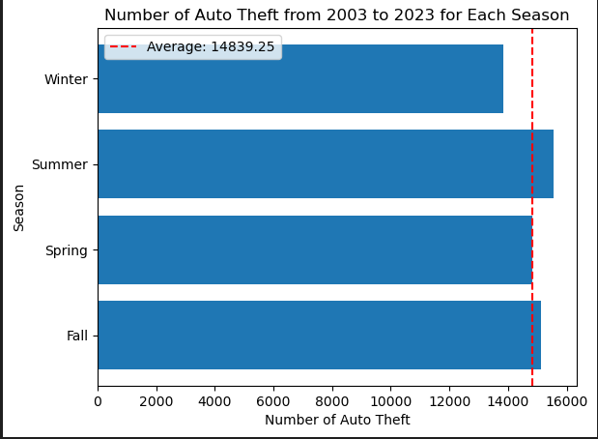
Auto Theft
Overall Data & Seasonal Average

Slide 12
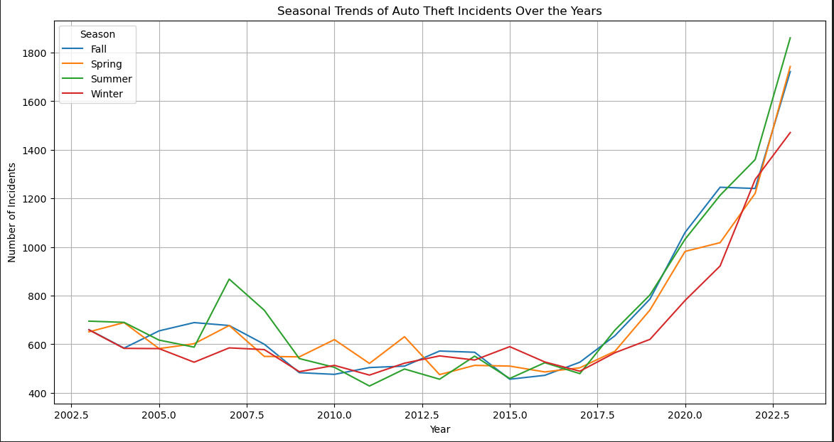

Slide 13
Test 4: Auto Theft across Seasons
N0: If seasons are not related to Auto theft, then particular seasons will not see an increase in identity theft.
N1: If seasons are related to auto theft, then particular seasons will show an increase in identity theft.
Results:
Chi-squared test: 55.06
P-value: 6.7e-12
Reject null hypothesis: Seasons do influence auto theft

Slide 14
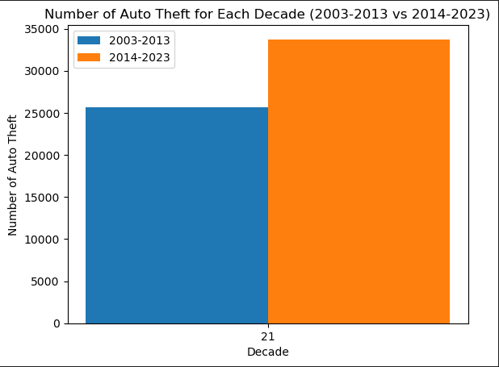
Comparison of Occurrences by Decade

Slide 15
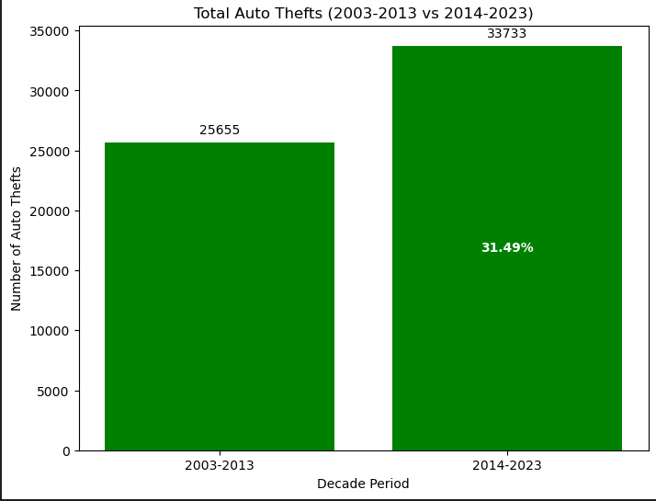
Increase in Number of Occurrences Compared to Previous Decade

Slide 16
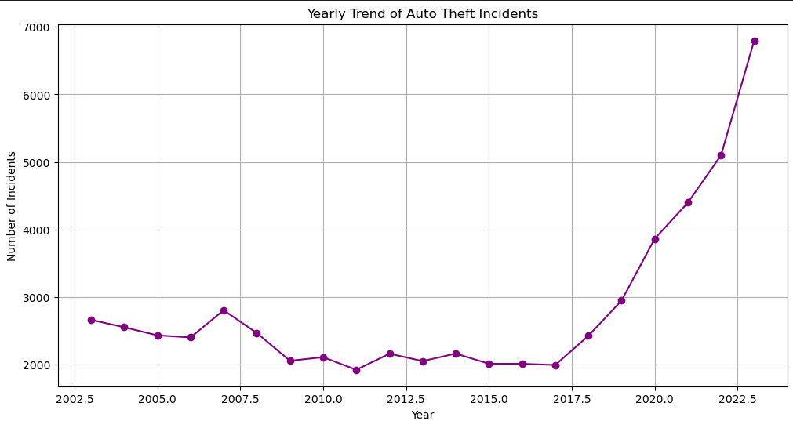
Total Percentage Increase in Auto Theft
Occurrences is approximately +155.05% over 20 Year Period
Auto Thefts Between 2014-2023 +213.80% of 33,733 Total Occurrences
Auto Thefts Between 2003-2013 -22.89%
Auto Thefts Between 2014-2023 +213.80%

Slide 17
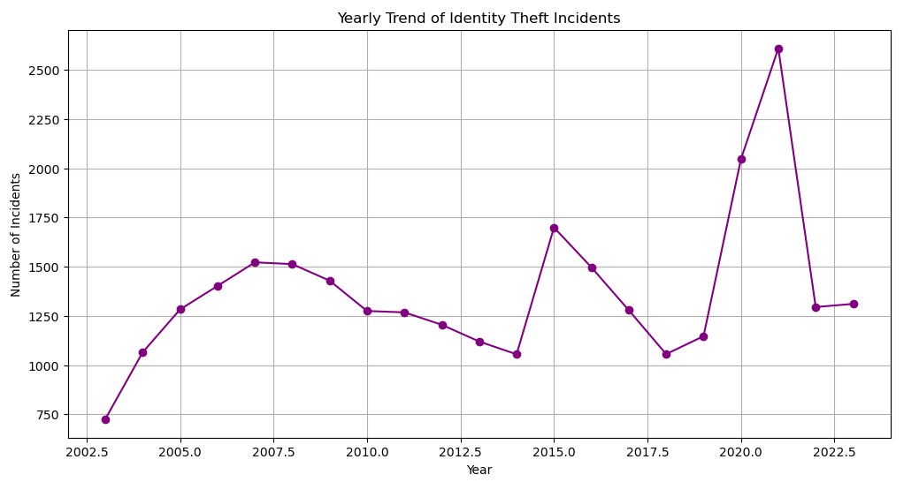
Identity Theft Over the Years

Slide 18
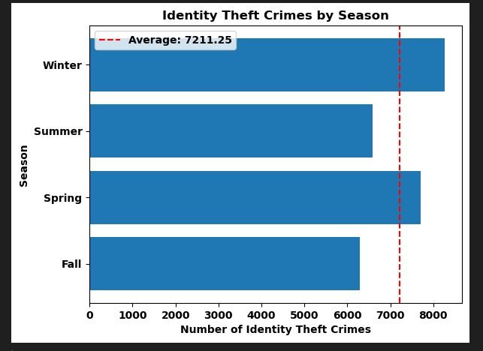
Identity Theft per Season
N0: If seasons are not related to identity theft, then the Winter months will not see an increase in identity theft.
N1: If seasons are related to identity theft, then the Winter months will show an increase in identity theft
Results:
Chi-squared test: 164.89
P-value: 1.61e-35
Reject null hypothesis: Seasons are related to identity theft.

Slide 19
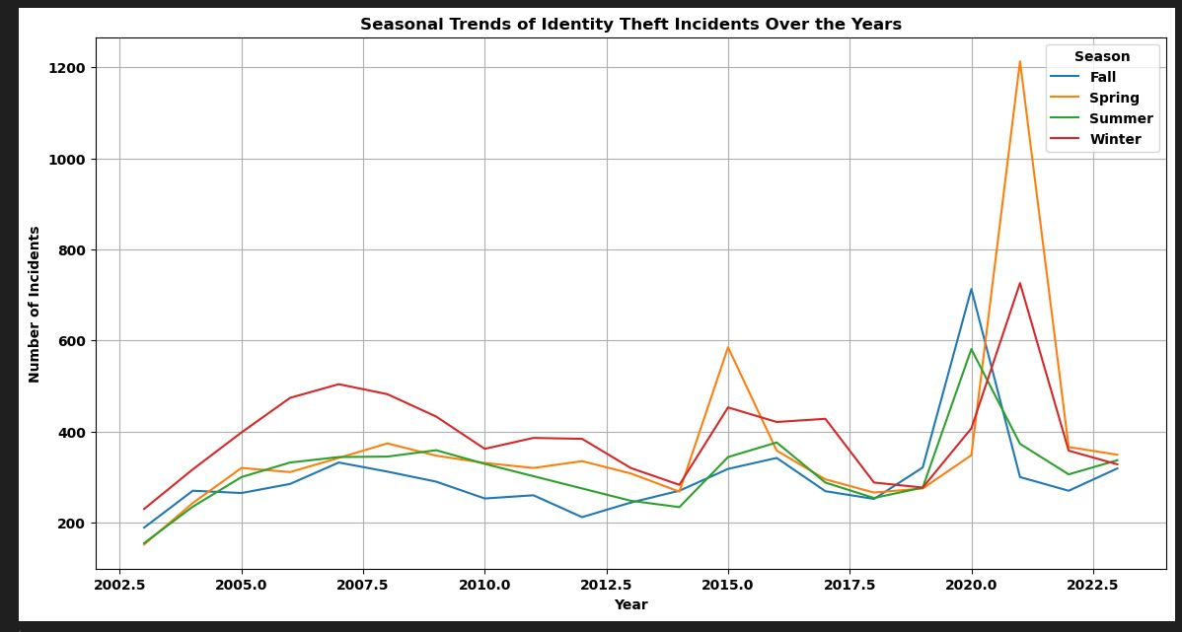
Identity Theft per Season

Slide 20
Overall Conclusion
Seasons do influence crime in residential burglaries, shoplifting incidences, auto thefts, bicycle thefts, and identity theft.

